Slide 1
A Brain That Cannot Recognize
Recognition is the process of matching representations of organized sensory input to stored representations in memory.
There are people who have no sensory deficit at all who nonetheless cannot readily recognize the objects around them. This condition, which is called agnosia (literally, “without knowledge”), results from damage to the brain, not to the sensory organs.
When sight is unimpaired and yet recognition fails, the deficit is known as visual agnosia.
Chapter 2
Notes:
The experience of a patient known as John illustrates the cause and effects of visual agnosia (Humphreys & Riddoch, 1987).
John, who grew up in England, was a pilot in World War II. After the war, he married and then worked for a company that manufactured windows for houses, in time becoming head of marketing for Europe. Following an emergency operation for a perforated appendix, he suffered a stroke: a small blood clot traveled to his brain and blocked the arteries that sustained tissue in the occipital lobes. After his stroke, although he was perfectly able to make out the forms of objects about him and nav­igate through his room, John was unable to recognize objects. He didn’t know their names or purposes. He was unable to read. Even after recovering from surgery and returning home, his ability to recognize objects did not fully return. He even had difficulty recognizing his wife.
When shown a line drawing of a carrot (Figure 2–17a), John remarked, “I have not even the glimmerings of an idea. The bottom point seems solid and the other bits are feathery. It does not seem logical unless it is some sort of brush.” When shown the drawing of an onion (Figure 2–17b), he said, “I’m completely lost at the moment. . . . It has sharp bits at the bottom like a fork. It could be a necklace of sorts.” Shown a set of line drawings like these, John recognized fewer than half. He was better at naming real objects than drawings, but nonetheless correctly named only two-thirds of the objects shown to him, even though they were very common objects such as a book and an apple. Asked to name the same objects by touch, John’s understanding or speaking the name of the objects, but instead a selective difficulty with visual recognition. (p. 70 – 71)

Slide 2
Types
1. Apperceptive agnosia
  - Unable to recognize simple shapes
2. Associative agnosia
  - Can’t recognize complex objects

Slide 3
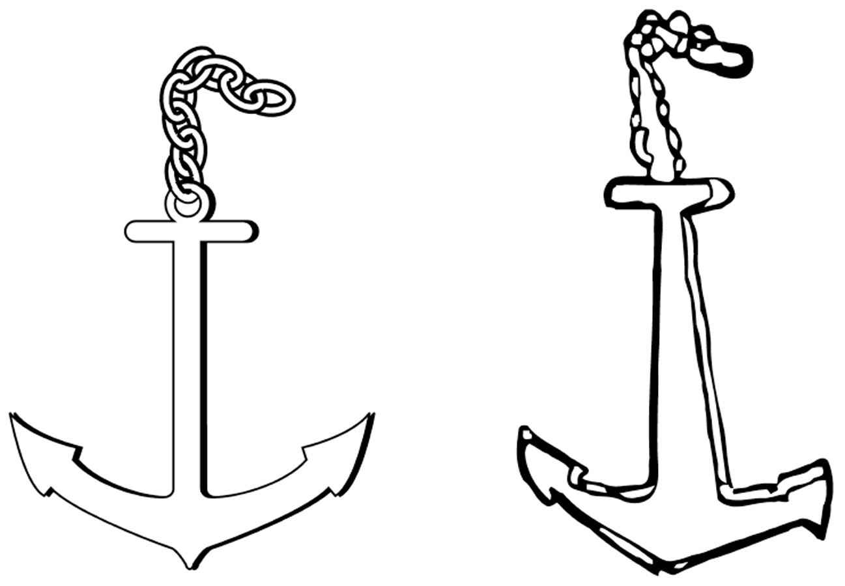
Drawing from a patient with associative agnosia

Slide 4
Theories
Template Matching
Feature Matching
Recognition by Components
Configural Models

Slide 5
Template-Matching Models
A template is a pattern, like a cookie cutter or a stencil. It can be used to compare in­dividual items to a standard.
The template-matching method as initially conceived is straightforward and useful as long as the item to be recognized and the template to which the system compares it are almost identical and different from others.
Template matching is the method used in modern computer programs to recognize bar codes and fingerprints. When the object to be identified is well specified and unique, template matching is a quick and reliable method.
Chapter 2

Slide 6
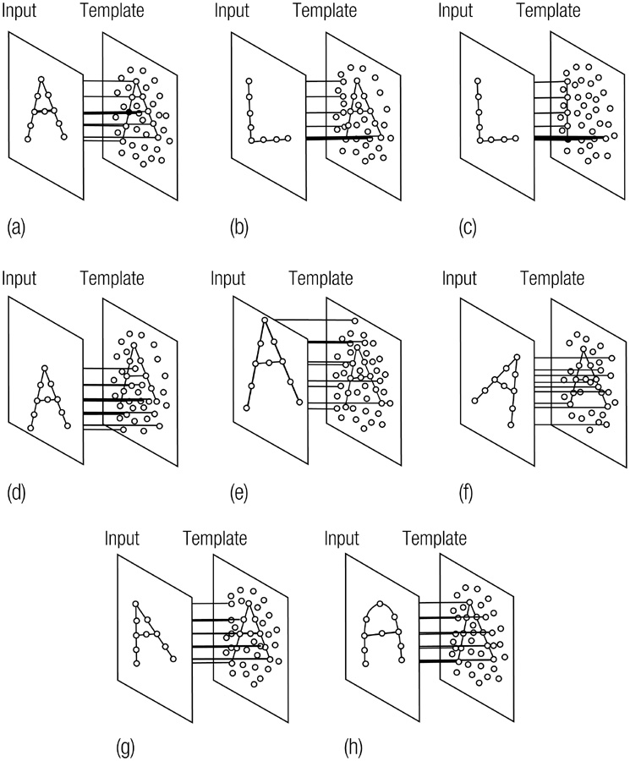
Examples of attempts to match templates to the letters A and L.

Slide 7
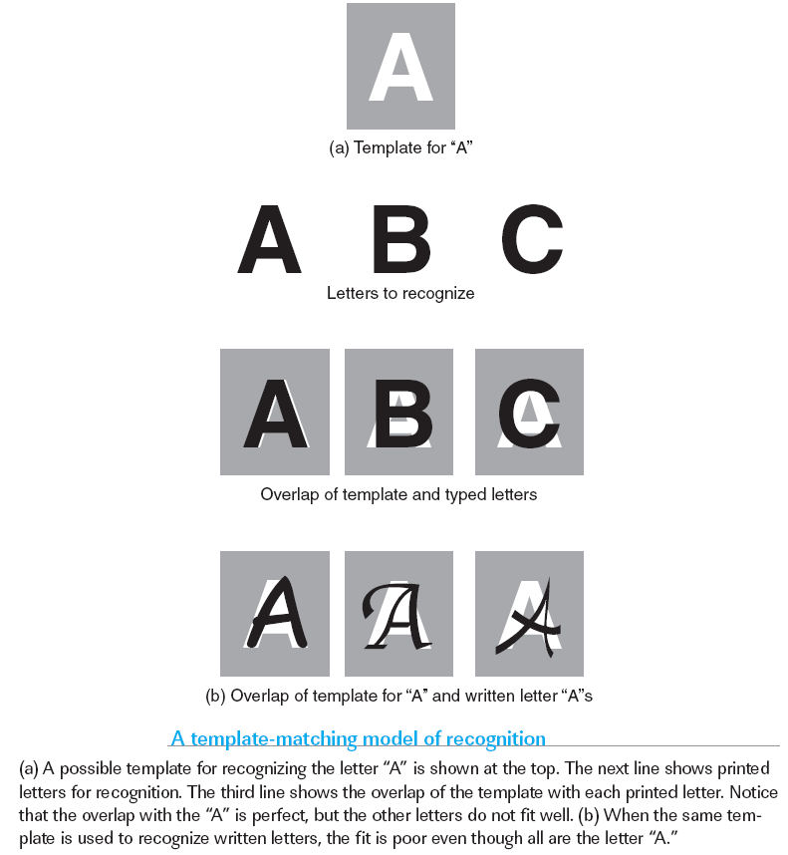
Template Matching

Slide 8
Template Matching
Problem: size, variation, view points
Several computer programs use this:
  What do you think?
Notes:
Would require a great flexibility to be able to do this in your head.
Bar codes, finger prints

Slide 9
Feature-Matching Models
Feature-matching models search for simple but characteristic features of an ob­ject; their presence signals a match. What constitutes a feature in these models? That varies with the type of object.
The feature-matching approach also lends itself well to the idea that processing of information in the brain is parallel (that is, happening at the same time) and distributed (that is, happening in different neural areas).
For a feature-matching model to be a plausible explanation of how we recognize objects, neurons or populations of neurons should show selectivity to parts of the input similar to the features in the model.
Chapter 2

Slide 10
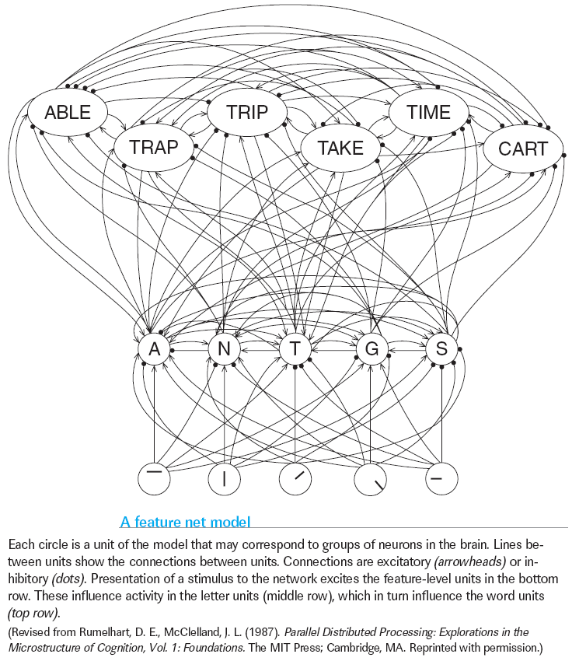
Chapter 2

Slide 11
Feature Matching
Good things:
  Less storage space
  Feature detectors are actually what’s in the brain

Slide 12
Recognition-by-Components Model
The recognition-by-components (RBC) model provides a possible method for recognizing three-dimensional objects across variations in viewpoint or exemplars (Biederman, 1987). (p. 78)
The model assumes that any three-dimensional object can be generally described according to its parts and the spatial relations among those parts.
The current model proposes that a set of 24 geometrical three-dimensional shapes, such as cylinders and cones, can be used to represent just about any object; in the language of the model, these shapes are called geons.
Chapter 2

Slide 13
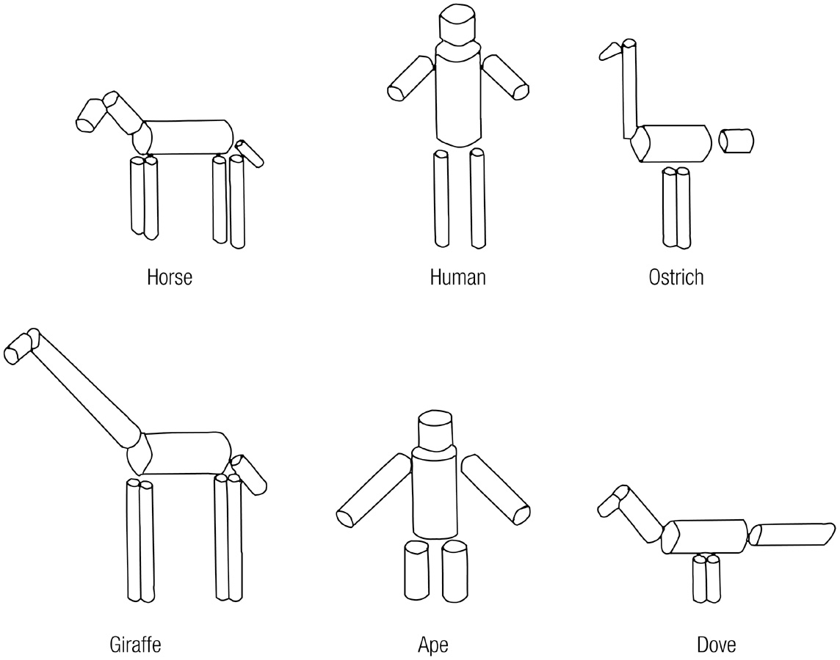
Segmentation of some familiar objects into basic cylindrical shapes.

Slide 14
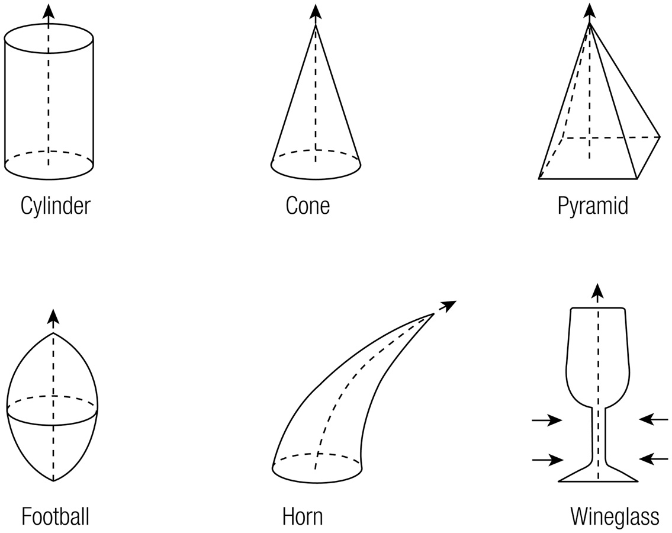
Examples of Beiderman’s (1982) proposed geons.

Slide 15
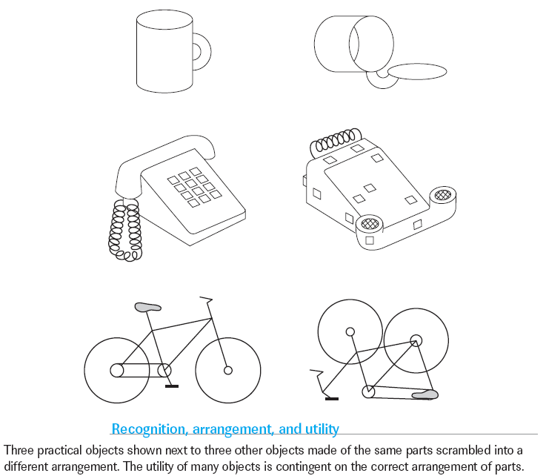

Slide 16
Configural Models
Configural models often can deal with the limitations of RBC models. They propose that objects that share the same parts and a common structure are recognized according to the spatial relations among those parts and the extent to which those spatial relations deviate from the prototype, or “average,” object.
Configural models of recognition help explain how we recognize different individual examples of a category; they have been especially successful in the domain of face recognition.
In a configural model, specific faces are described by their deviations from the prototypical face, as defined by quantified average proportions in a population. All faces would have the same component parts in the same spatial arrangement, but their relative sizes and distances make each unique.
Chapter 2
Notes:
Several lines of evidence support the configural theory of face recognition. For one thing, we are somewhat better at recognizing caricatures of famous faces, which accentuate the differences from the average face, than more veridical line drawings; this finding suggests that we code faces according to such deviations (Rhodes et al., 1987). Studies have also shown that participants instructed to stare at a particular face and then look at an average face may briefly experience a visual aftereffect in which they perceive the “opposite” or “anticaricature” of the original face (Leopold et al., 2001; Webster & MacLin, 1999; Webster et al., 2004; Zhao and Chubb, 2001). (p. 82)

Slide 17
Face Recognition
Prosopagnosia
  Selective difficulties in recognizing faces
Fusiform gyrus
  Region of the temporal lobe that responds when faces are present in the visual field

Slide 18
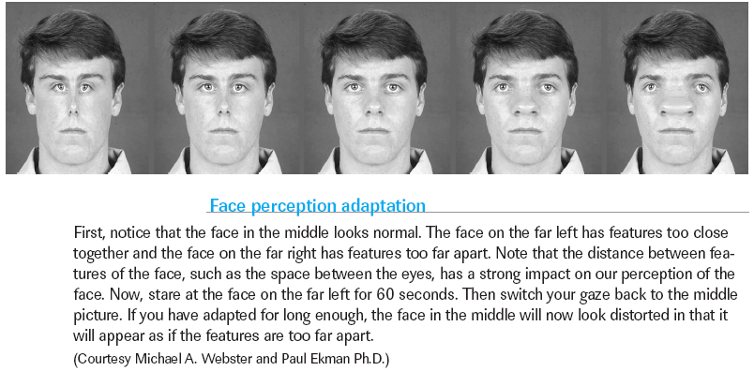
Face Recognition

Slide 19
Top Down Context
Notes:
All that was bottom up.

Slide 20
Context Effects for Feature and Group Processing
Information is interpreted by our perceptual systems relative to context across all levels of perceptual representation and processing.
Our perceptual system has heuristics—problem-solving short-cuts, as opposed to exhaustive algorithms—for making sense of the world by making inferences from the information it receives. Perception is the result of these inferences.
Visual illusions demonstrate how perception can infer properties that do not exist in the image.
Chapter 2

Slide 21
Context Effects for Object Recognition
Recognition is dependent on our previous experience with the world and the context of that experience:
Recognition of an object may be improved if it is seen in an expected context (you’d agreed to meet your friend at the diner).
Or a customary one (your friend often eats at that diner).
Recognition may be impaired if the context is unexpected (what’s my cousin from Australia doing at this U.S. diner?).
Or inconsistent with previous experience (I’ve never seen you here before!).
Chapter 2

Slide 22
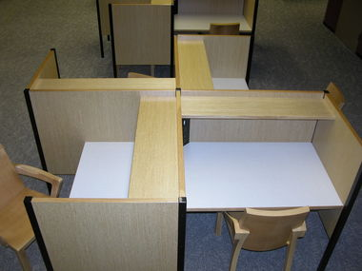

Slide 23
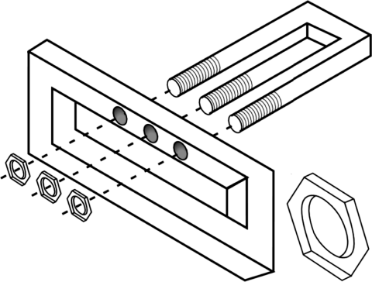

Slide 24
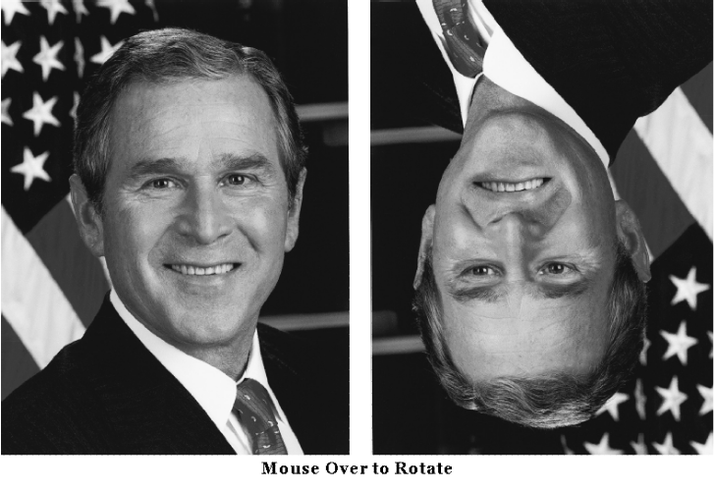
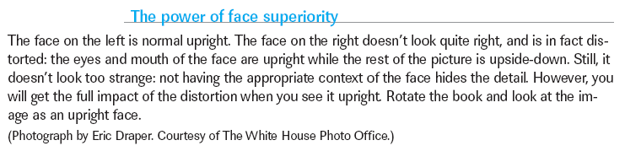

Slide 25
Top Down
Word superiority effect
  We like words!

Slide 26
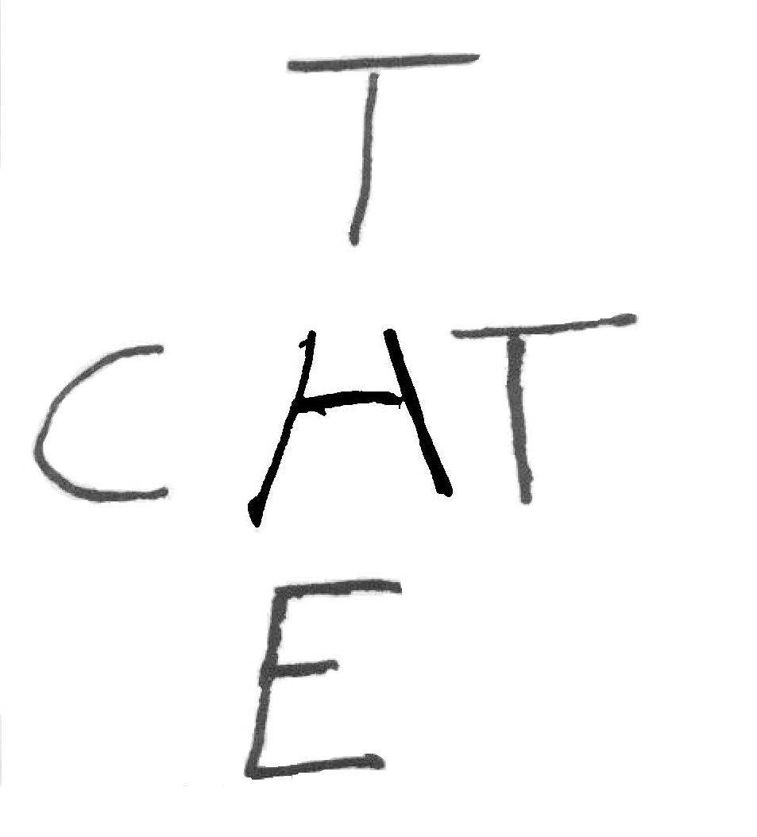

Slide 27
We don’t like to think hard…
Therefore we expect things to constant:
  Brightness
  Size
  Shape
  Color

Slide 28
Conclusions
Sensation and perception interact.
  Both from a feature level and context level.

